Slide 1
SPORTS
Made by: Nagy Levente, Szeidler Bence

Slide 2

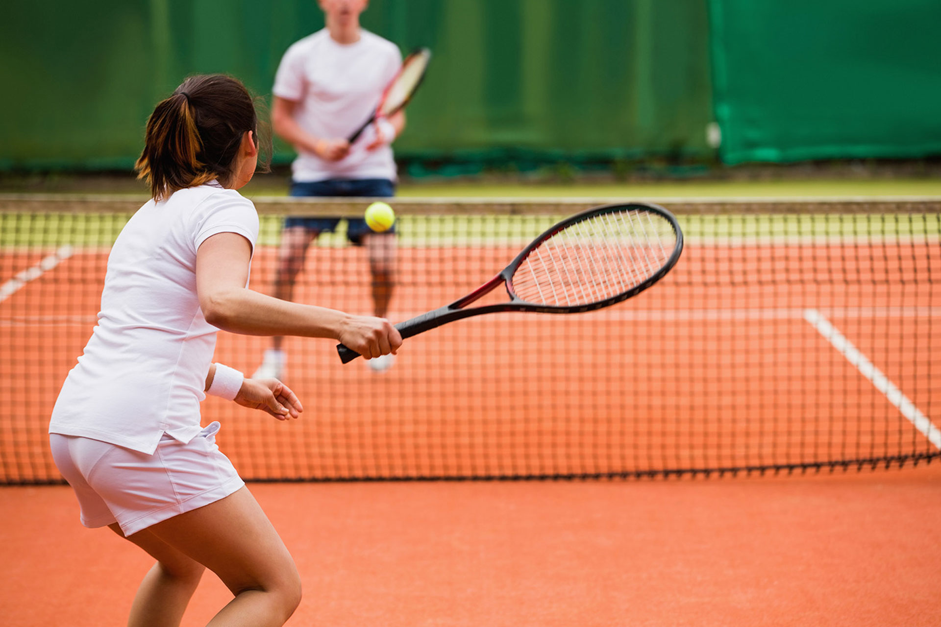
INDOOR AND OUTDOOR
INDOOR SPORTS
They require less preparation
They can’t be played in any room
BASKETBALL
VOLLEYBALL
HANDBALL
Futsal
Chess
OUTDOOR SPORTS
They have a larger playing field
Most of them are heavily affected by the wind and other weather conditions
FOOTBALL
TENNIS
SKIING
Cycling, running

Slide 3
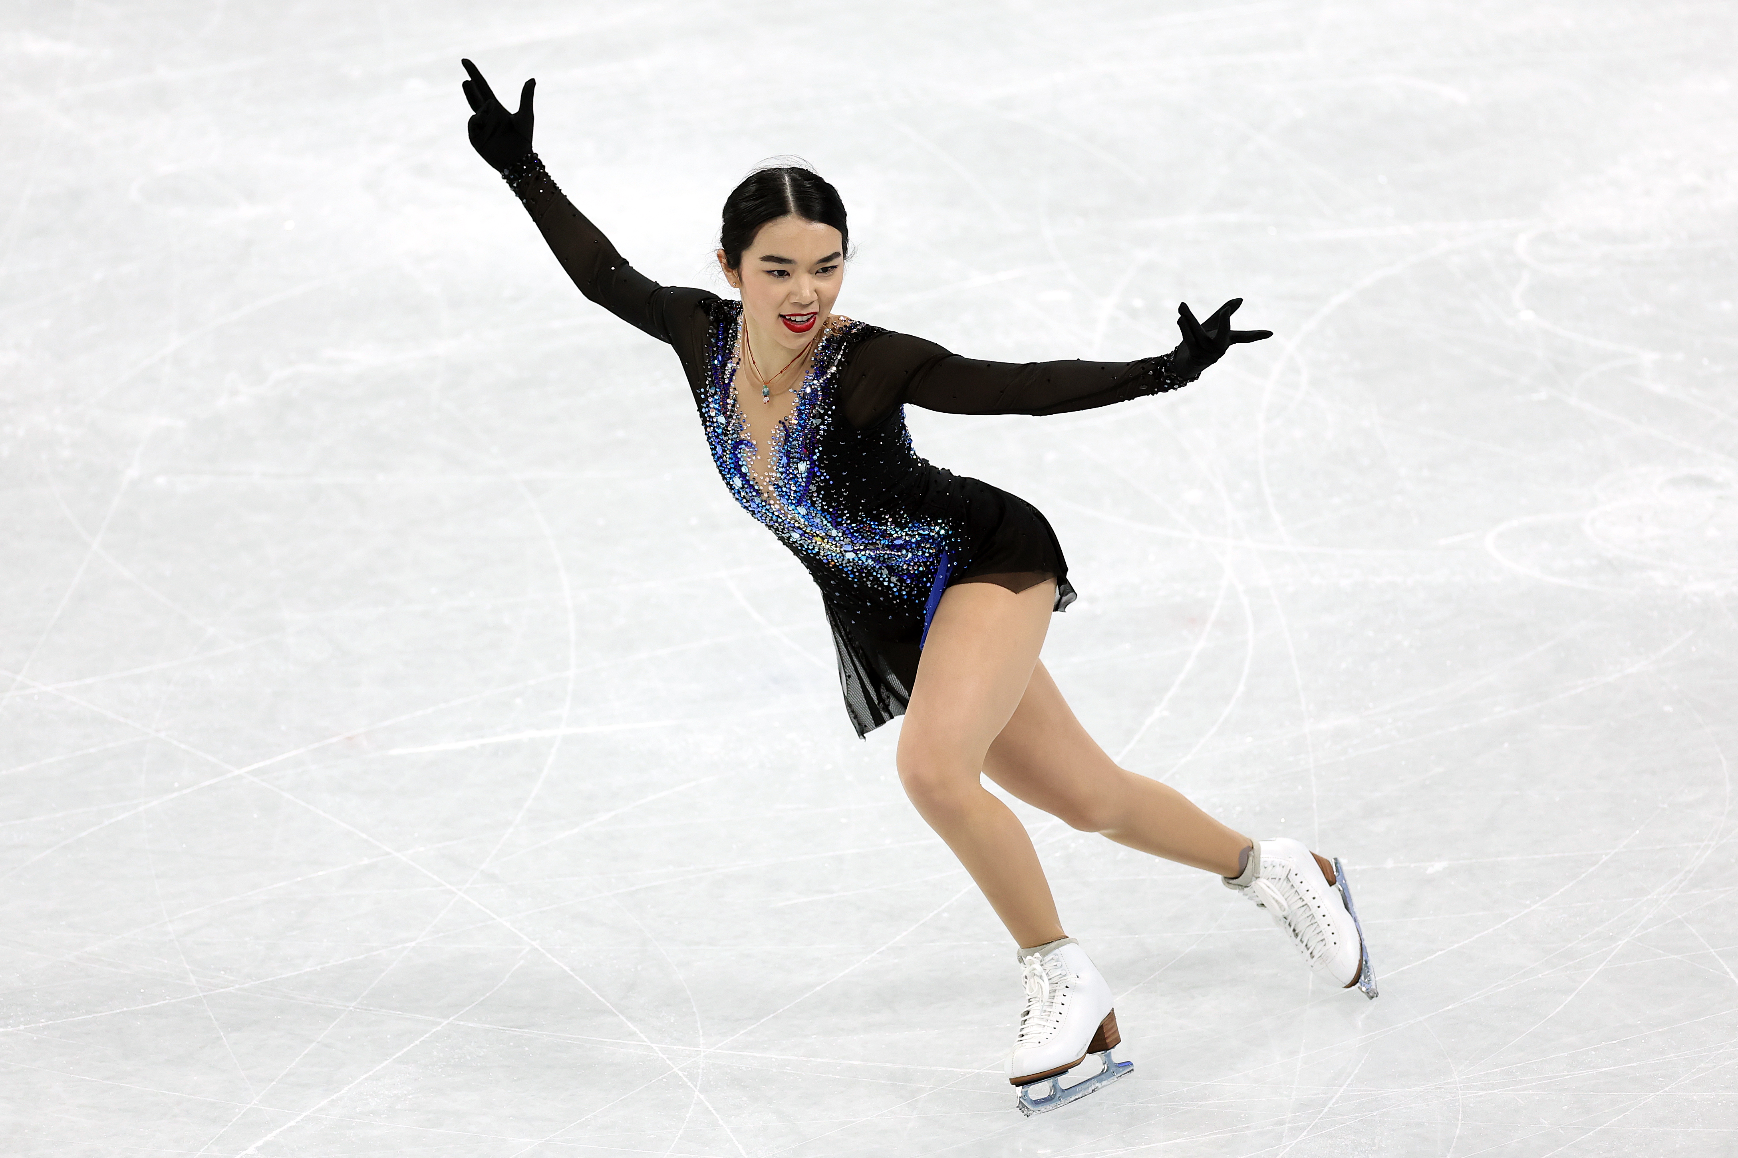
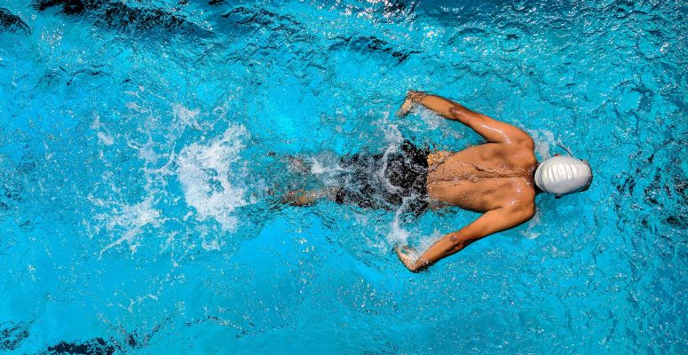
SEASONAL
WINTER SPORTS
Most are only available if the temperature is right
Some of them need a lot more gear and preparation
ICE HOCKEY
SKIING
ICE SKATING
SUMMER SPORTS
Depend less on weather
Depends more on playing field
FOOTBALL
TENNIS
SWIMMING
Beachball

Slide 4
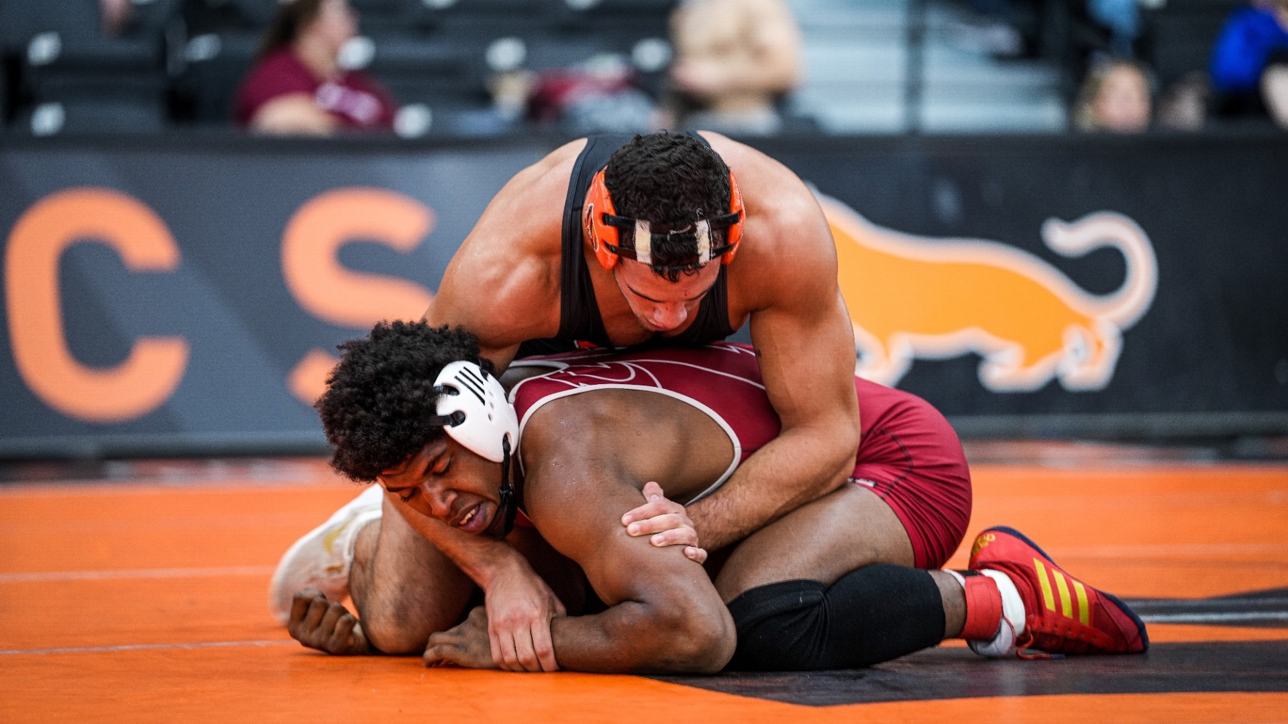
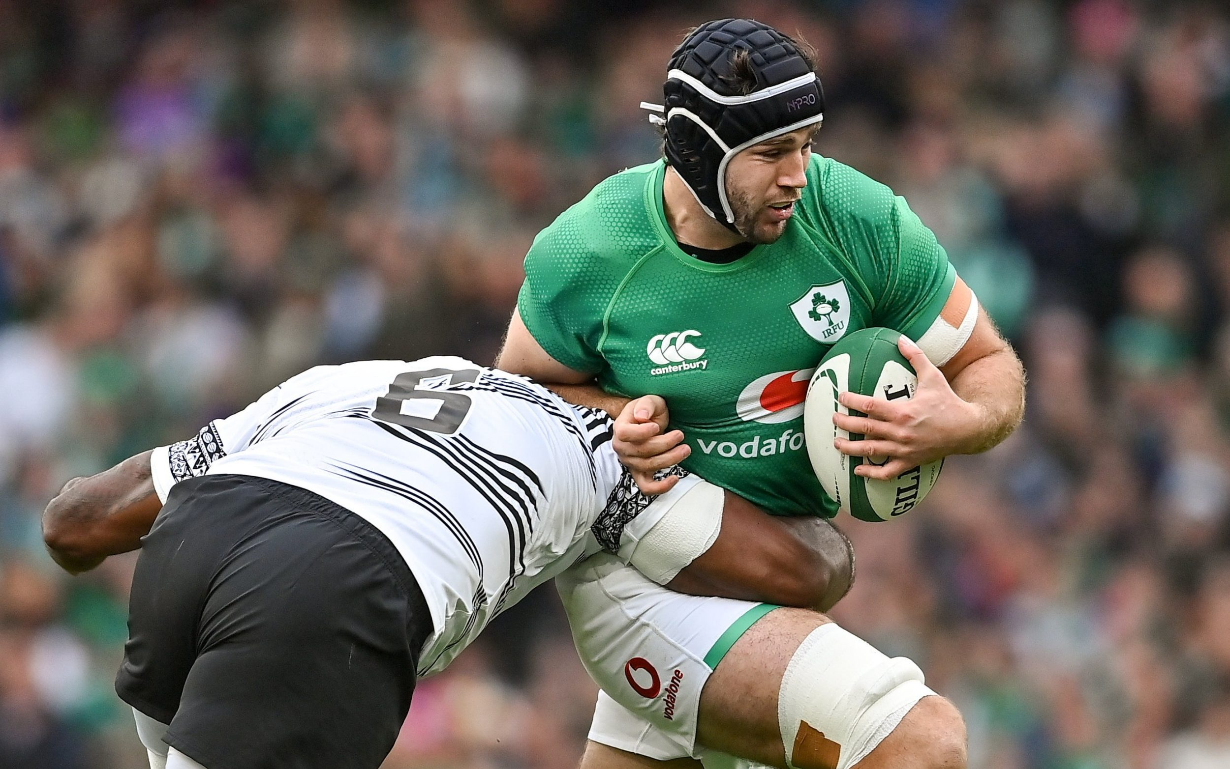
INDIVIDUAL AND TEAM SPORTS
INDIVIDUAL SPORTS
Players have to learn strategies during the game
Players have to know their opponent’s strengths
TABLE-TENNIS
WRESTLING
DARTS
Martial arts
chess
TEAM SPORTS
Teamplay is necessary to win the match
The players can be changed around
VOLLEYBALL
AMERICAN FOOTBALL
RUGBY

Slide 5
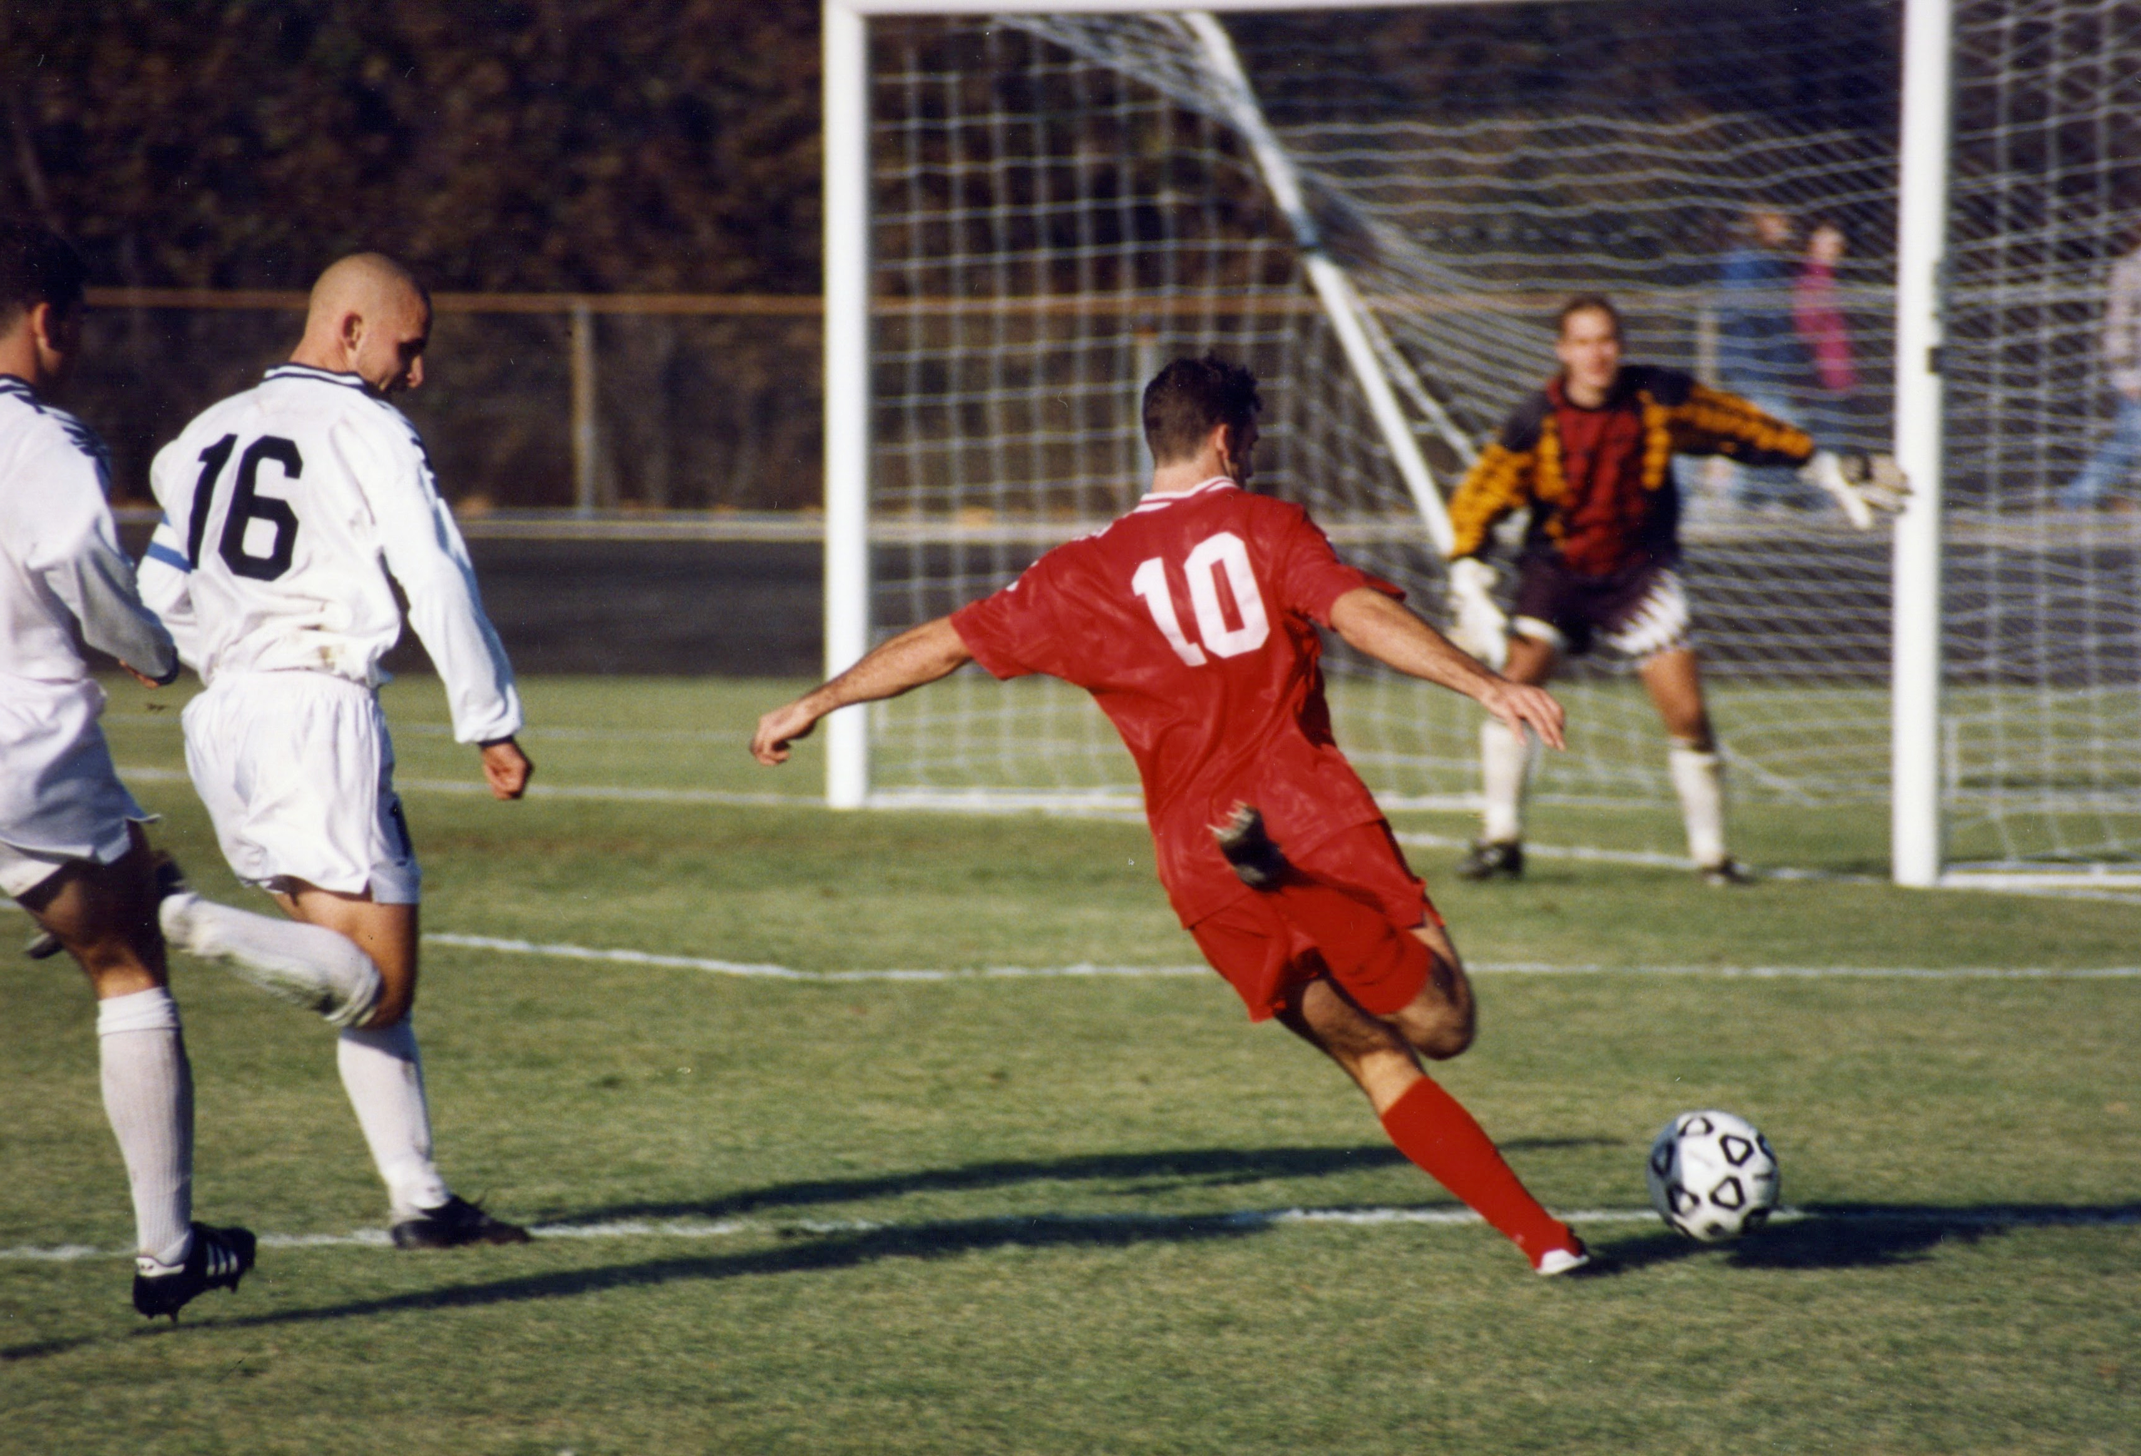
DIFFERENCES BETWEEN TRADITIONAL AND E-SPORTS
TRADITIONAL SPORTS
REQUIRE MORE TRAINING and more physical activity
THEY ARE PLAYED IN REAL PLACES
PLAYERS REPRESENT A COUNTRY

Slide 6

DIFFERENCES BETWEEN TRADITIONAL AND E-SPORTS
E-SPORTS
PLAYERS RARELY REPRESENT A COUNTRY
PARTICIPANTS CAN PLAY FROM COMFORTABLE PLACES
Harmful for your eyes

Slide 7
THANKS FOR YOUR ATTENTION

Slide 8
SOURCES
https://cavtat-tenis.com/
https://www.vac.hu/hirek/sport/21560/1/Kezilabda-%E2%80%93-uj-rendszerben,-ket-vaci-csapattal-az-NB-II-ben.html
https://www.wsav.com/weather-news/storm-team-3-now/winter-olympics-2022-ice-skating-ice-rink-science/
https://www.runnersworld.hu/edzes/uszas-elonyei-futoknak
https://goprincetontigers.com/news/2023/11/1/mens-cross-country-princeton-wrestling-opens-2023-24-season-with-princeton-open
https://www.telegraph.co.uk/rugby-union/2023/09/01/best-rugby-players-in-the-world-up-part-five-20-1/
https://en.wikipedia.org/wiki/Esports
https://en.wikipedia.org/wiki/Association_football

